Slide 1
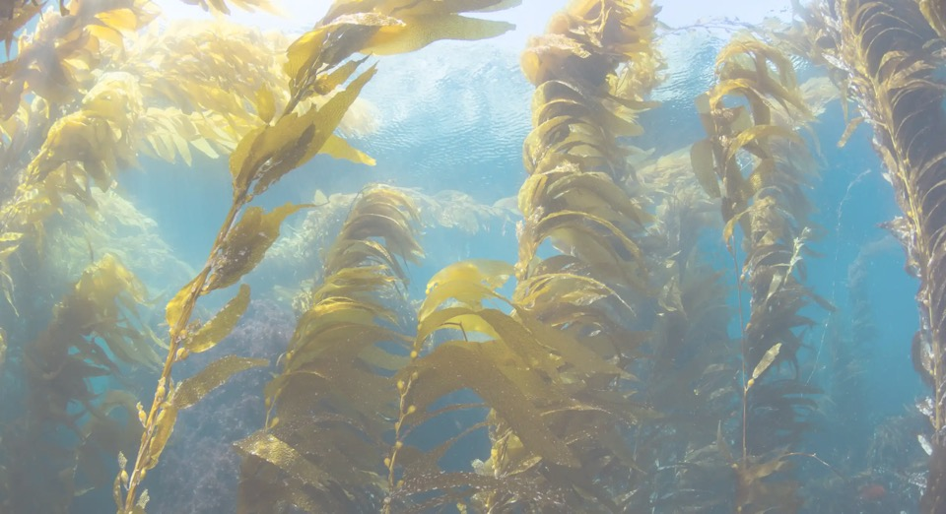
Identify Seaweed Distribution in the BC Coast Using Sentinel-2 Satellite Imagery
By KELP TEAM
Xi Sun V00025479
Ting Liu V00045129
Zheng Yin V00915261

Slide 2
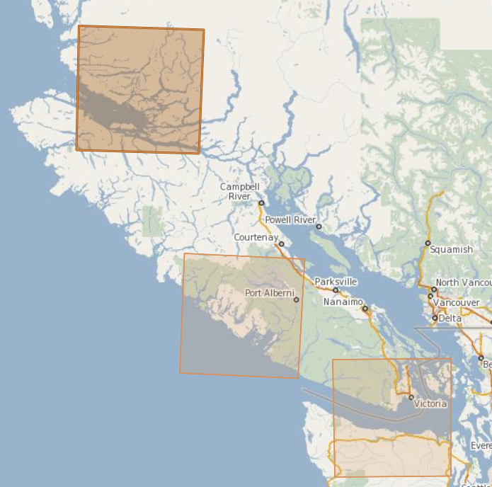
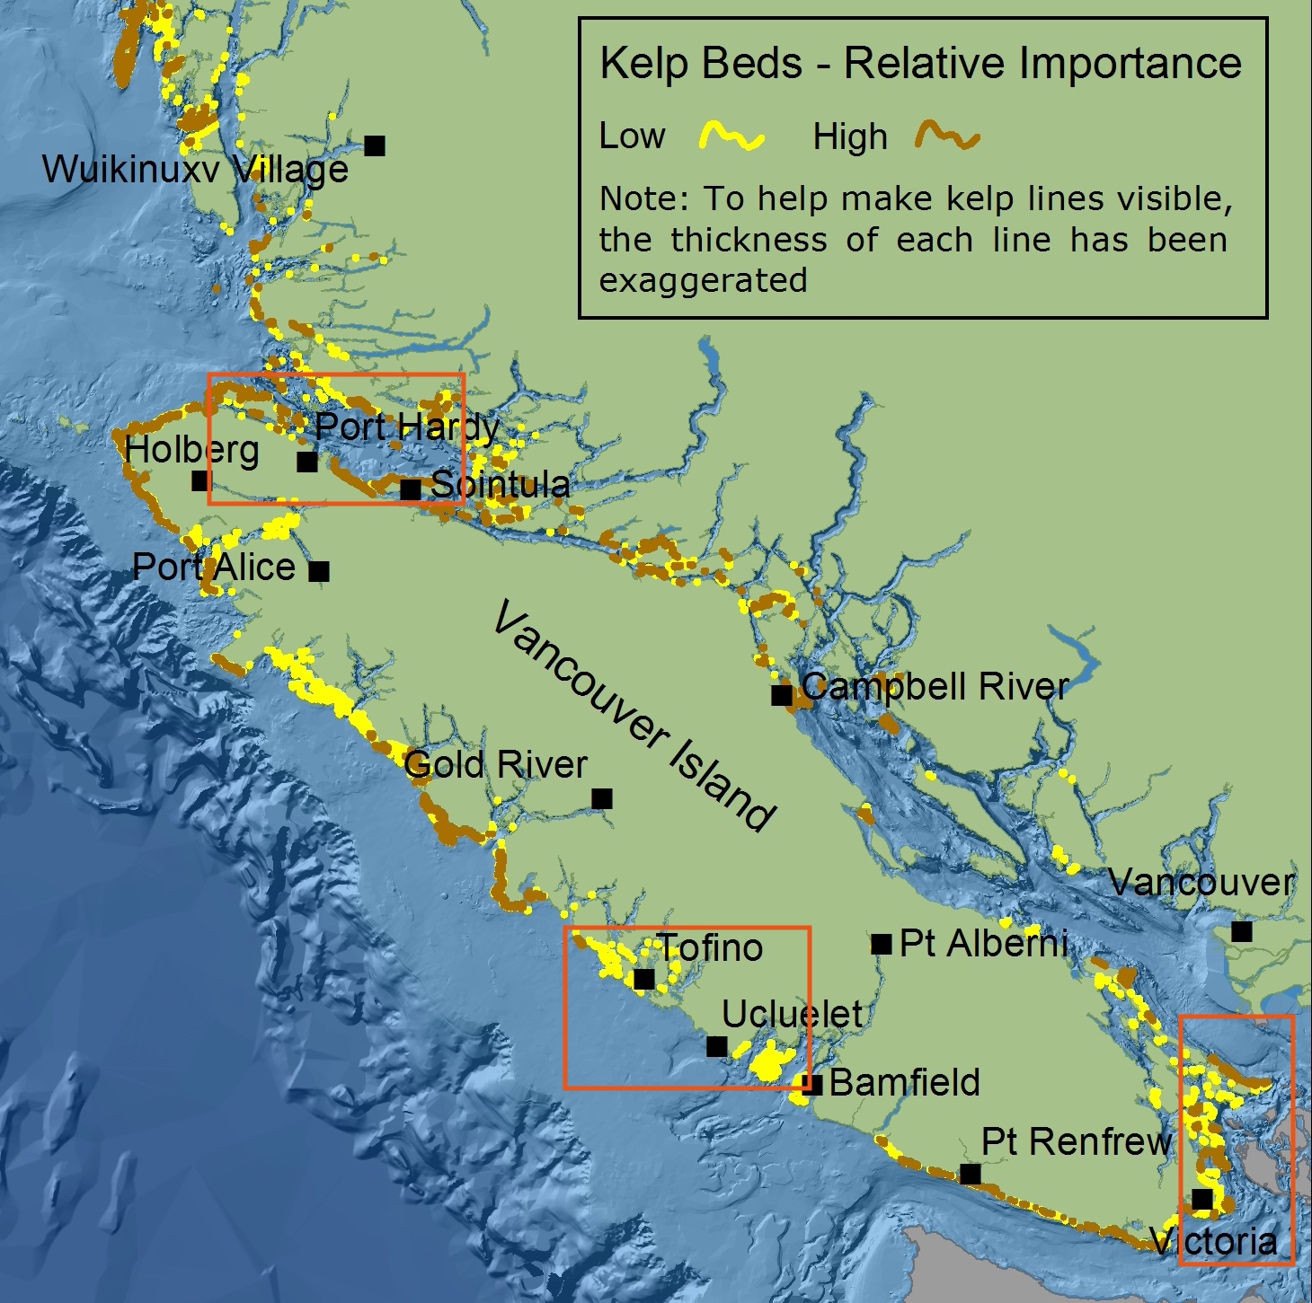
Test Sites And Data Source
Tool: dhusget.sh
https://scihub.copernicus.eu/twiki/do/view/SciHubUserGuide/BatchScripting#dhusget_script
Location: 3 test sites.
#LOCATION='Victoria'
#COORDS='-123.8,48.7:-123.1,48.3'
#LOCATION='Tofino'
#COORDS='-126.7,49.5:-125.4,48.9'
LOCATION='PortHardy'
COORDS='-128.5,51:-126.7,50.4'
Time: 2021-06-01 - current
DATE_START=$(cat "latest.txt")
DATE_END=$($date_cmd +%Y'-'%m'-'%d)
Source: Sentinel 2 MSI Level_2 Imagery
TOPTION='S2MSI2A'
FOPTION='platformname:Sentinel-2'
Command:
$CMD ./dhusget.sh $OPTIONS -S $YEAR'-'$MONTH'-'$DAY'T00:00:00.000Z' -E
$YEAR'-'$MONTH'-'$DAY'T23:59:59.000Z' -O $OUT_DIR

Slide 3
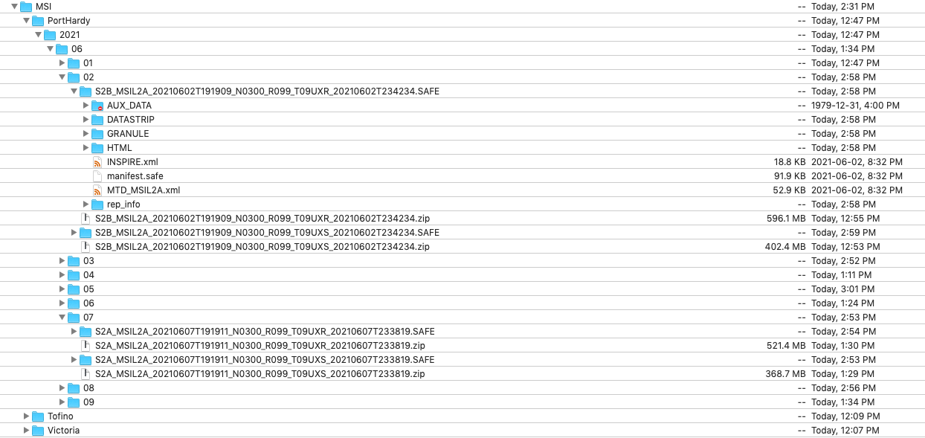
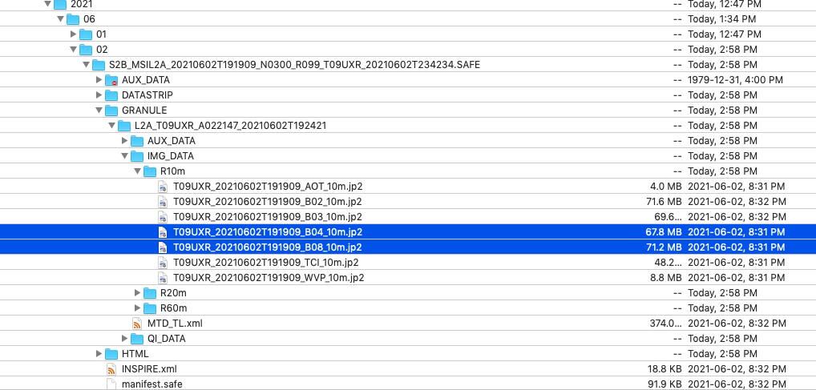
Data Structure
Download Folder:
Sensor/Location/Year/Month/Day/.zip
Unzip all to .SAFE folder
Browse to find jp2 data of band 4/8

Slide 4
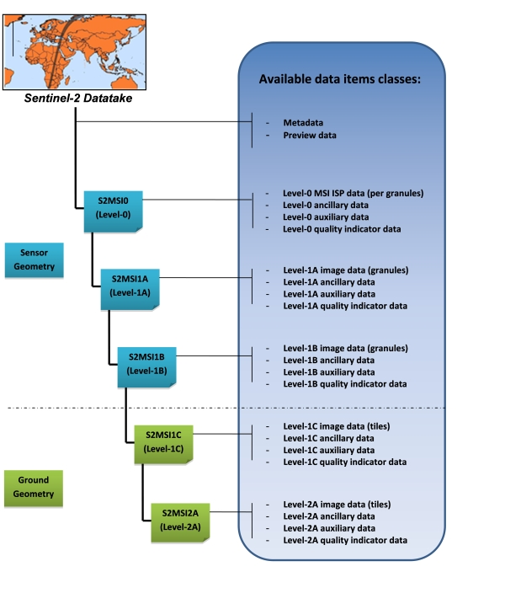
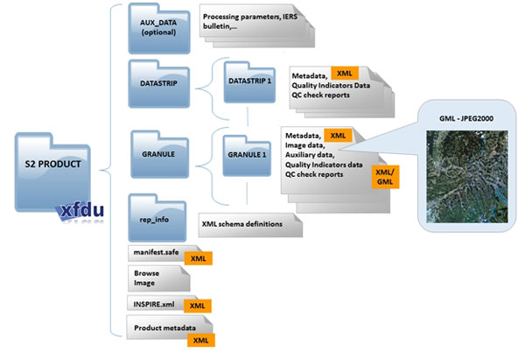
Data Structure
Data Format
orthorectified products (Level-1C and Level-2A) - made available to Users.
metadata file (XML file)
preview image (JPEG2000 with GML geo-location)
tiles files with BOA reflectances image data file (GML / JPEG2000) for each tile
datastrip files
auxiliary data
ancillary data (Ground Image Processing Parameters (GIPPs))
https://sentinel.esa.int/web/sentinel/user-guides/sentinel-2-msi/data-formats

Slide 5
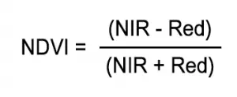
NDVI
NDVI
Using QGis to extract band 04 (RED) and band 08 (NIR) from S2 SAFE files to calculate NDVI
NDVI < 0.4 non-vegetated habitats
NDVI > 0.4 and < 0.5 vegetated habitats (seagrass in our case)
https://docs.qgis.org/3.16/en/docs/pyqgis_developer_cookbook/index.html
[1] Barillé, Laurent, et al. "Increase in seagrass distribution at Bourgneuf Bay (France) detected by spatial remote sensing." Aquatic Botany 92.3 (2010): 185-194

Slide 6
Colab
Connect to Arubuts using Paramiko
Download B04 and B08 jp2 files to Google cloud GFS
Read jp2 files using RasterIO and calculate NDVI
Save results as GeoTiff files.
Upload results to Arbutus

Slide 7
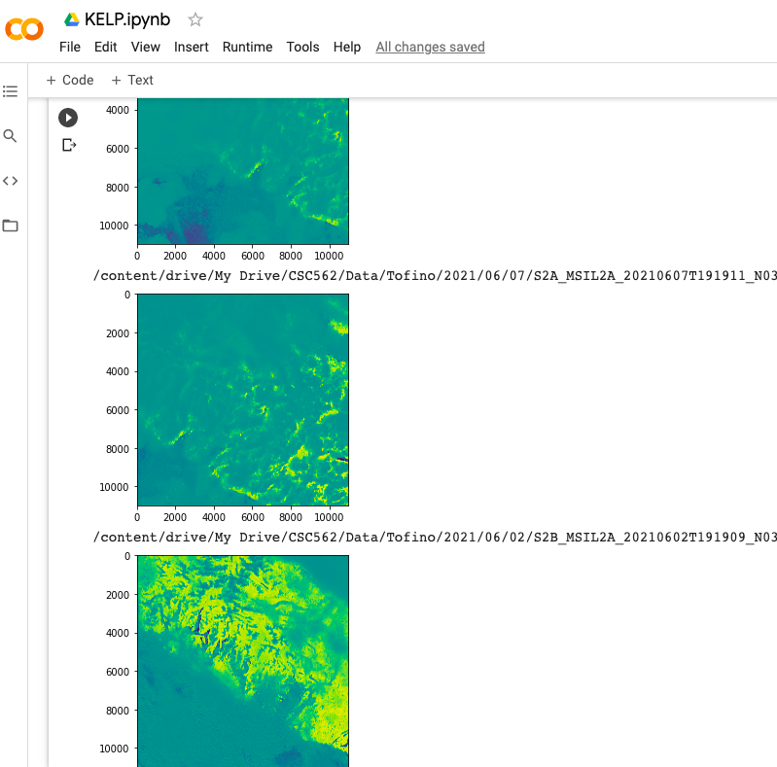
Colab
Visualized result of NDVI tiff data
in Colab
(Automatically rendering)

Slide 8
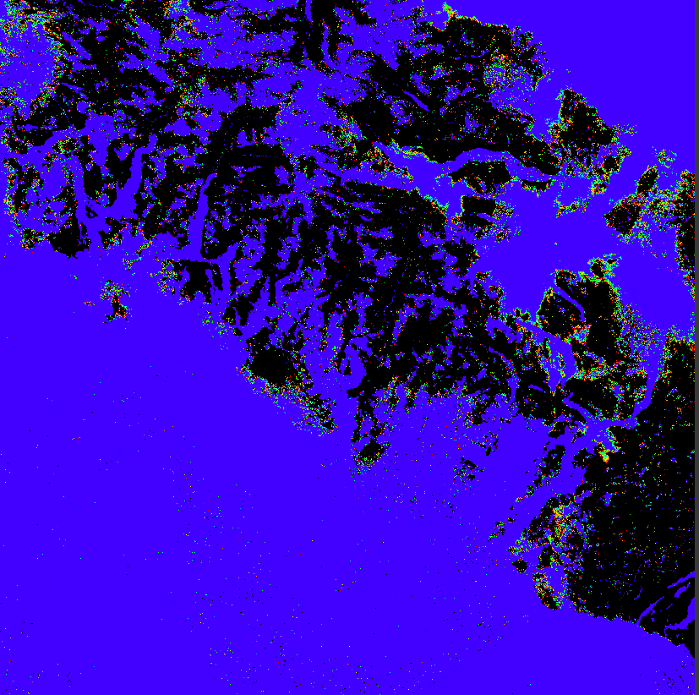
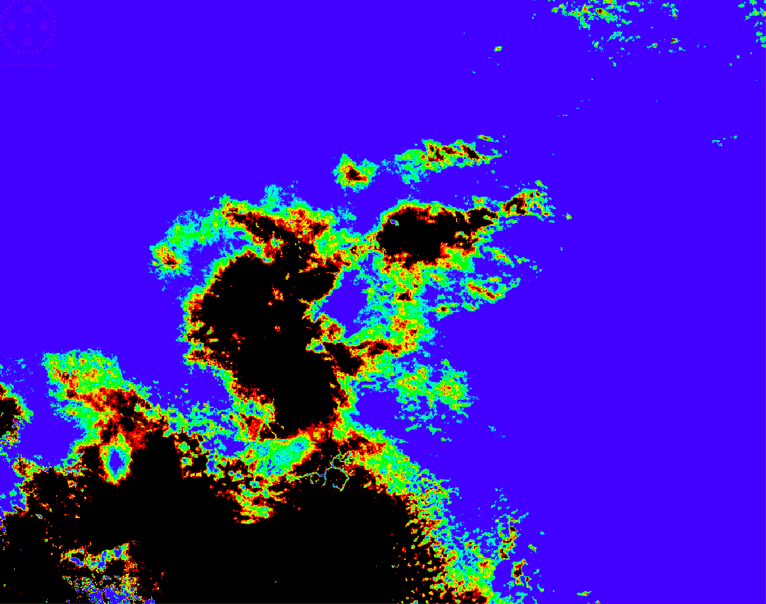
SNAP
Analyze NDVI data
Filter NDVI value in [0.4, 0,5]

Slide 9
Next Step
Apply Spark in Google Colab to speed up computation
Single file acceleration (Mapreduce VS Sequential computation)
NDVI calculation time 0.86 s
Total map-reduce time 20.50 s
Multi-files acceleration (ongoing)
Total calculation time 758.20
Total calculation time using MapReduce 739.00 s
Use Spark Dataframe
Web server for visualization

